Slide 1
Words and numbers
Lecture 3: towards the general linear model

Slide 2
Course outline
Lecture 1 – Basics of quantitative methods
Philosophical assumptions
Research design
Lab 1 – how to approach a data set
Lecture 2 – Basic concepts for statistics
Samples and populations
Models and hypothesis testing
Lab 2 – testing assumptions and hypotheses
Lecture 3 – towards the general linear model
Correlation
Regression
General linear model
Lab 3 – correlation and regression

Slide 3
Lecture 3
Correlation and covariance
Observational data (revision)
Covariance
Correlation co-efficient (r)
What is the general linear model
Statistical model (revision)
Linear equation
General

Slide 4
Lecture 3
Correlation and covariance
Observational data (revision)
Covariance
Correlation coefficient (r)
What is the general linear model
Statistical model (revision)
Linear equation
General

Slide 5
Revision…
Types of study
Experiment
Observation
Quasi-experimental design

Slide 6
Revision…
What’s an experiment
Example – attractiveness on facebook
Clear distinction between dependent and independent variables
Clear distinction between what’s being measured and what’s being manipulated
Can make inferences about “cause” and “effect”
Viewing habits for attractive and unattractive facebook profiles
Manipulate attractiveness of fake profile picture into 2 groups
Measure eye movements and viewing time for each group
Does attractiveness cause viewing behaviour?
Paired samples t-test

Slide 7
Revision…
What’s an observation
Example – attractiveness on facebook
No independent variables, only dependent variables
Nothing is manipulated, measure things as they spontaneously occur, when they occur
No cause, only correlation
Viewing habits of attractive and unattractive facebook profiles
No control over profiles viewed
Measure viewing time for different real profiles from ISP → rate attractiveness later
Is there a correlation between perceived attractiveness and viewing time?
Correlation!

Slide 8
The question…
Is viewing time correlated with perceived attractiveness?
Is a change in viewing time related to a change in perceived attractiveness?
Is the mean viewing time associated with the mean attractiveness rating
Is this association reliable and not just i.e. random
Do viewing time and attractiveness covary?
To understand co-variance, we need to first refresh on variance
We get variance in the second last step when calculating standard deviation

Slide 9
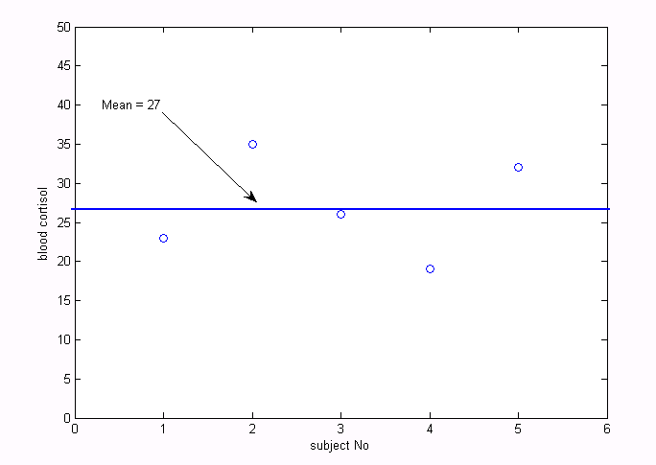
The average (i.e. standard) distance (i.e. deviation) of each score from the mean
We need to know
Distance from x₁to µ +
Distance from x₂ to µ +
Distance from x₃ to µ +
Distance from x₄ to µ +
Distance from x₅ to µ/
n
SD = 6.52
We could calculate
(27-23) +
(35-27) +
(27-26) +
(27-19) +
(32-27)
/5 = 6.52
Sample 1
x₁ = 23
x₂ = 35
x₃ = 26
x₄ = 19
x₅ = 32
µ = 27
n = 5
µand x_{n}keep switching sides on the minus sign
But this is too inefficient
we can’t turn this into a general equation!

Slide 10
The average (i.e. standard) distance (i.e. deviation) of each score from the mean
To avoid this we
(x₁–µ)² +
(x₂ – µ)² +
(x₃ – µ)² +
(x₄ – µ)² +
(x₅ – µ)² /
n
SD = 6.52
What are we doing
Squaring the difference between the scores and the mean
Square makes everything the same sign
But this gives us the square of the summed differences
Sum of squared errors/n
Variance
So to finish we
Take the square root (√)
i.e. we “unsquare” everything
Sample 1
x₁ = 23
x₂ = 35
x₃ = 26
x₄ = 19
x₅ = 32
µ = 27
n = 5
Square root of the sum of squared errors, divided by n

Slide 11
Population standard deviation
Sample standard deviation
Sample variance
Sample variance
Keep this in mind

Slide 12
Our question again
Is viewing time correlated with perceived attractiveness?
Is a change in viewing time related to a change in perceived attractiveness?
Is the mean viewing time associated with the mean attractiveness rating
Is this association reliable and not just i.e. random
Do viewing time and attractiveness covary?
Change in y
Viewing duration
Associated with
Change in x
Perceived attractiveness

Slide 13
Our question again
Is viewing time correlated with perceived attractiveness?
Is a change in viewing time related to a change in perceived attractiveness?
Is the mean viewing time associated with the mean attractiveness rating
Is this association reliable and not just i.e. random
Do viewing time and attractiveness covary?
Variance in y
Viewing duration
Associated with
Variance in x
Perceived attractiveness

Slide 14
Sample variance
Sample co-variance
Let’s look at an example

Slide 15
Mean = 4
Viewing duration
Mean = 3.4
Perceived attractiveness

Slide 16
Mean = 3.4
Viewing duration
Mean = 4
Perceived attractiveness
…….?

Slide 17
A problem of scales
Seconds
Why is this a problem
We want to talk about attractiveness and viewing time
But we can only talk about seconds and our rating scale
If we change the scale, we change cov(x,y)
Personal rating
Viewing duration
Perceived attractiveness
We need a standardised scale

Slide 18
Revision…
Z-score:
Standardises the scores
Transforms the score so that it is in units of standard deviation
E.g. attractiveness rating of 4 →x standard deviations above the mean
Sample mean
Score
Sample standard deviation
This is the trick, divide by s

Slide 19
Divide by standard deviation…
Pearson’sr
Correlation coefficient
Where…
s_{x}= standard deviation of x(i.e. attractiveness)
And…
s_{y} = standard deviation of y(i.e. viewing time)

Slide 20
Interpreting r
r = 0
No correlation
No relationship between x and y
r = 0 → 1
Positive correlation
Increase in x associated with increase in y
E.g. More viewing time for more attractive profiles
r = -1 → 0
Negative correlation
Increase in x associated with decrease in y
E.g. Less viewing time for more attractive profiles

Slide 21
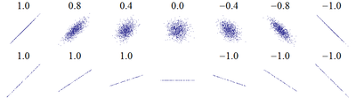
Interpreting r
r = 0 → .3
Weak correlation
Slightly “clustered” around line
r = 0 → .8
Strong correlation
Tightly clustered around line
r = 0
No correlation
No pattern
Values are heuristics
Interpretation depends on topic
r tells you the level of clustering, not the slope

Slide 22
Interpreting r
A correlation is an effect like e.g. difference between two means
Two means can look different due to chance, without being different
Two variables can look correlated due to chance, without being correlated
How do we know whether our correlation is significant
We do a t-test, and get a p-value

Slide 23
…revision…
Mean of sample of miners
Mean of normal population
Difference between sample and population means
Estimation of how well the sample mean represents the miners
Standard error –
“how well does our sample mean represent the population of miners”

Slide 24
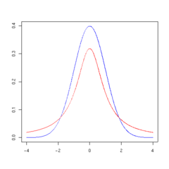
… revision …
t-distribution: similar to the normal curve
Parameter defining its centre
Parameter defining its dispersion
Area under curve = probability of 1
We can ask the probability of getting a t-statistic of more than e.g. 2.13
Area under the relevant part of the curve
p = .041 (we can look this up in a table)
Red: t-distribution
Blue: normal distribution
tdistribution is fatter because its an estimate
p-value: keyconcept in statistics
Will come up constantly

Slide 25
General form of a test statistic
Effect we are measuring
Error related to sampling

Slide 26
t-test for correlation coefficient
Effect we are measuring
Error related to sampling

Slide 27
Interpreting r
“Correlation does not imply causation”
Intervening variables
Red wine and life expectancy
Direction of causation
Diabetes and obesity
Co-incidence
Pirates and global warming

Slide 28
Lecture 3
Correlation and covariance
Observational data (revision)
Covariance
Correlation co-efficient (r)
What is the general linear model
Statistical model (revision)
Linear equation
General

Slide 29
What is the general linear model
Model (revision)
Description of a phenomenon in terms of its most relevant parameters
Linear
Parameters describe a straight line
Regression
General
Multiple regression
Basic form of many parametric statistics
Social science on the natural sciences model

Slide 30
What is the general linear model
Model (revision)
Description of a phenomenon in terms of its most relevant parameters
Linear
Parameters describe a straight line
Regression
General
Multiple regression
Basic form of many parametric statistics
Social science on the natural sciences model

Slide 31
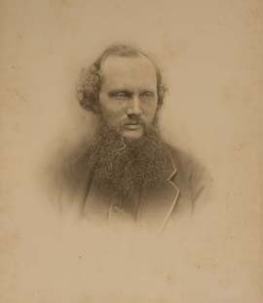
Statistical model revision
Mechanical model
Description of a physical phenomenon in terms of its most relevant physical properties
Where relevant is defined relative to a explanatory or predictive goal
Statistical model
Description of a phenomenon in terms of its most relevant statistical parameters
“I am never content until I have constructed a mechanical model of the subject I am studying. If I succeed in making one, I understand; otherwise I do not.”

Slide 32
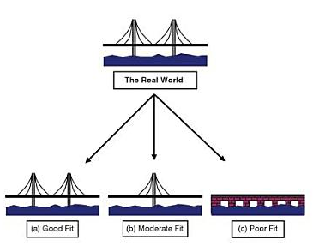
Statistical model revision
Engineering task
Build a bridge
First step
Construct a physical model for testing
Requirement
Right physical properties
Right conditions

Slide 33
Statistical model revision
Mechanical model
Description of a physical phenomenon in terms of its most relevant physical properties
Where relevant is defined relative to a pragmatic or explanatory goal
Statistical model
Description of a phenomenon in terms of its most relevant statistical parameters
“I am never content until I have constructed a mechanical model of the subject I am studying. If I succeed in making one, I understand; otherwise I do not.”

Slide 34
Statistical model revision
Engineering task
Build a bridge
First step
Construct a physical model for testing
Requirement
Right physical properties
Right conditions
Research task
Explain something
First step
Construct a statistical model
Requirement
Good parameter estimates
Minimise confounds, right manipulations, etc.

Slide 35
What is the general linear model
Model
Description of a phenomenon in terms of its most relevant parameters
Linear
Parameters describe a straight line
Regression
General
Multiple regression
Basic form of many parametric statistics
Social science on the natural sciences model

Slide 36
Linear model
Plot variables on axes
IV on x
DV on y
Starting income
Years in university

Slide 37
A note on terminology
Independent variable
Implies manipulation
No manipulation in correlation studies
Predictor
Dependent variable
Implies manipulation
No manipulation in correlation studies
Outcome

Slide 38
Linear model
Plot variables on axes
Predictor on x
Outcome on y
Take one measure
Take another measure
Extrapolate
Starting income
We need to describe
What happens when predictor not there
How does change in predictor change outcome
How do we describe it
Y-intercept
Slope
Years in university
How does this work???

Slide 39
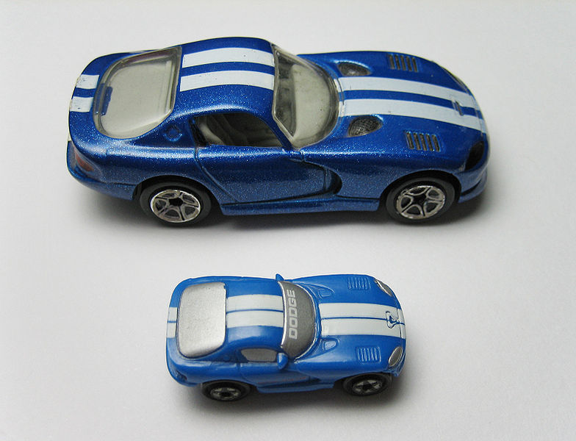

Northward component (km)
1
2
3
4
5
6
1
2
3
4
5
6
Eastward component (km)

Slide 40
For every 3 km east
Car moves 3 km north
Northward component (km)
Change in y
Slope =
= 1
1
2
3
4
5
6
Change in x
From the slope you can tell for every
1 km east
1 km north
Where the car starts
1
2
3
4
5
6
Eastward component (km)

Slide 41
Northward component (km)
1
2
3
4
5
6
1
2
3
4
5
6
Eastward component (km)

Slide 42
For every
2 km east
4 km north
Northward component (km)
1
2
3
4
5
6
Slope = 2
For every
1 km east
2 km north
Where the car starts
1
2
3
4
5
6
Eastward component (km)
-y-intercept tells us where the car started
-Slope tells how much distance covered in the northward component, per kilometer covered in the eastward component

Slide 43
Monthly income (x 10000)
1
2
3
4
5
6
1
2
3
4
5
6
Years after university

Slide 44
Change in y
Slope =
= .5
Change in x
For every
6 years after uni
3 or more (x 10000)
Monthly income (x 10000)
1
2
3
4
5
6
Where the car starts
From the slope you can tell for every
1 year after uni
5000 kr more
1
2
3
4
5
6
Years after university
-y-intercept tells us income when years after uni = 0
-Slope tells how much income increases per year after uni

Slide 45
Change in y
Slope =
= .5
Change in x
For every
6 years after uni
3 or more (x 10000)
Monthly income (x 10000)
1
2
3
4
5
6
Where the car starts
From the slope you can tell for every
1 year after uni
5000 kr more
1
2
3
4
5
6
Years after university
-y-intercept tells us baseline of outcome
-Slope tells how much outcome changes due to the predictor (effect of predictor)

Slide 46
Same slope, different y-intercept
Different baseline
Different things happen when no predictor variable
Same effects
Same thing happens when predictor variable added
Happiness
business
research
Income

Slide 47
Same y-intercept, different slope
Same baseline
Same thing happens when no predictor variable
Different effects
Different things happen when predictor variable added
Happiness
business
research
Income
Negative slope for research: negative effect
Happiness decreases with higher income
Same as for correlation

Slide 48
Linear equation
Is there a general way to relate the predictor, the outcome, the y-intercept, and the slope?
Monthly income
Linear equation
y = mx + b
Years after university

Slide 49
Linear model
y-intercept = baseline; slope = effect
Linear equation – algebra
y = mx + b
outcome = slope(predictor) + y-intercept
Linear model – regression
Y_{i} = b₀+b₁X_{i} +ε_{i}
Same as saying (y = b +mx)
How’s that the same?

Slide 50
Linear model
Y_{i} = b₀+b₁X_{i} +ε_{i}
Score on independent variable.
Model error
y-intercept:
baseline
slope:
Effect
Regression
coefficient
This is new, what’s this?
Score on
dependent variable

Slide 51
Model of linear relationship
e.g. y = 1x + 1
Viewing duration
Perceived attractiveness
-Real data doesn’t follow an exact line

Slide 52
What’s ε_{i}?
Tells you the difference between your linear model and your real data
Tells you how well your model explains the data
Tells you how well your model fits the data
Error term
Residual

Slide 53
b₁
ε₃
-Model error
-Residual
Y₃
b₀
X₃
Y_{i} = b₀+b₁X_{i} +ε_{i}
i = 3

Slide 54
Importance of ε_{i}
Tells you how well your model fits the data
ε_{i} tells you how well data point i follows the model
Adding up the ε’sfor each point tells you how well all the data follows the model
We can’t just add, the signs will cancel

Slide 55
+
-
+
-
-
Y_{i} = b₀+b₁X_{i} +ε_{i}

Slide 56
Importance of ε_{i}
Tells you how well your model fits the data
ε_{i} tells you how well data point i follows the model
Adding up the ε’sfor each point tells you how well all the data follows the model
We can’t just add, the signs will cancel
Do the same as for standard deviation
Take the sum of the squared residuals

Slide 57
SS_{M} (model sums of squares)
A measure of how good the model is
But what does good mean?
Good relative to what?
SS_{M}
= combined squared distance of all the data points from the line representing the model Y_{i} = b₀+b₁X_{i} +ε
_{i}= combined error of all the data points considering the influence of the predictor

Slide 58
Linear models can be better or worse fits to the data
The best model is the one with the lowest error term simultaneously for each data point
Line of best fit, regression line, least squared line

Slide 59
So how do we quantify the fit of a linear model???

Slide 60
We ask how much of the total variance (i.e. variability of outcome around its own mean) can be explained by the model

Slide 61
Divided by
SS_{M}
= combined squared distance of all the data points from the line representing the model Y_{i} = b₀+b₁X_{i} +ε
_{i}= combined error of all the data points, considering the influence of the predictor
SS_{T}
= combined squared distance of all the data points from the line representing the mean
= combined error of all the data points not considering the influence of the predictor

Slide 62
Statistic for quantifying the fit of a model
-The line of best fit, regression line, or least squared line is the one with the highest possible R²
-Does this have any relation to the correlation co-efficient r
-Yes, it is r, butsquared

Slide 63
What have we been doing?
Linear equation
Correlation
Most parametric statistics

Slide 64
Before we move on…
The problems of scales again….
Significance of the slope or effect

Slide 65
A problem of scales
Just like for correlation….
Starting income
Years after university
We need a standardised scale

Slide 66
Revision…
Z-score:
Standardises the scores
Transforms the score so that it is in units of standard deviation
E.g. 4 years after university→x standard deviations above the mean
If we standardise the scales first
Our model usually means more
We get standardised regression coefficient
Called β instead of b
Sample mean
Score
Sample standard deviation
This is the trick, divide by s

Slide 67
Unstandardised regression model
Y_{i} = b₀+b₁X_{i} +ε_{i}
Standardised regression model
Y_{i} = β₀+β₁X_{i} +ε_{i}
ALMOST ALWAYS USE A STANDARDISED MODEL IN SOCIAL SCIENCES

Slide 68
Interpreting b
The slope of a predictor is an effect like e.g. difference between two means
Two means can look different due to chance, without being different
The slope of a predictor can look different from zero even though it isn’t
How do we know whether our predictor is significant
We do a t-test, and get a p-value

Slide 69
What is the general linear model
Model
Description of a phenomenon in terms of its most relevant parameters
Linear
Parameters describe a straight line
Regression
General
Multiple regression
Basic form of many parametric statistics
Social science on the natural sciences model

Slide 70
What is the general linear model
Model
Description of a phenomenon in terms of its most relevant parameters
Linear
Parameters describe a straight line
Regression
General
Multiple regression
Basic form of many parametric statistics
Social science on the natural sciences model

Slide 71
Northward component (km)
1
2
3
4
5
6
1
2
3
4
5
6
Eastward component (km)

Slide 72

Northward component (km)
Vertical component (km)
1
2
3
4
5
6
1
2
3
4
5
6
Eastward component (km)

Slide 73
Change in y
Vertical Slope =
=1
Northward component (km)
Change in z
Vertical component (km)
1
2
3
4
5
6
Change in y
Eastward Slope =
=4
Change in x
1
2
3
4
5
6
Eastward component (km)

Slide 74
Change in y
Length Slope =
=1
Monthly income
Change in z
Length of education
1
2
3
4
5
6
Change in y
Years after Slope =
=4
Change in x
1
2
3
4
5
6
Years after university
-y-intercept tells us income when years after uni& length of education = 0
-”Years after” Slope tells how much income increases per year after uni
-”Length” Slope tells how much income increases as length of education increases

Slide 75
Change in y
Length Slope =
=1
Monthly income
Change in z
Length of education
1
2
3
4
5
6
Change in y
Years after Slope =
=4
Change in x
1
2
3
4
5
6
Years after university
-y-intercept tells us baseline of outcome
-Slope 1 tells how much outcome changes due to predictor 1 (effect of predictor 1)
-Slope 2 tells how much outcome changes due to predictor 2 (effect of predictor 2)

Slide 76
Linear model
Y_{i} = b₀+b₁X_{i,1}+b₂X_{i,2}+ε_{i}
Model error
Score on dependent variable.
Score on
independent variable for predictor 2
y-intercept:
baseline
slope:
Effect of predictor 2
slope:
Effect of predictor 1
Score on
independent variable for predictor 1

Slide 77
Linear model
Y_{i} = b₀+b₁X_{i,1}+b₂X_{i,2}+ε_{i}
Standardise in the same way
Calculate R² in the same way
Can have as many predictors as you want
Y_{i} = b₀+b₁X_{i,1…} +b_{n}X_{i,n}+ε_{i}

Slide 78
Methods of regression
Forced entry
Add all the predictors at once
Heirarchical
Add predictors in fixed order and watch how R² changes
Good for comparing predictors
E.g. does adding length of education significantly improve the model of starting income, or is the amount of time after graduating sufficient on its own
Delta R²
Stepwise
Get computer to add and remove predictors until it comes up with the optimal R²

Slide 79
What is the general linear model
Model
Description of a phenomenon in terms of its most relevant parameters
Linear
Parameters describe a straight line
Regression
General
Multiple regression
Basic form of many parametric statistics
Social science on the natural sciences model

Slide 80
One of last week’s scenarios
Scenario:
Sociologist employed by a mining company to measure chronic stress among employees
New research question:
Does the shift a miner works on affect his/her stress levels?
Operational definition
Chronic stress is elevated levels of blood cortisol
Dependant variable
Blood cortisol in mcg/dL
A new null hypothesis
Night and day shift workers have the same blood cortisol levels
Night and day shift workers come from the same population (i.e. same parameters)
A new alternative hypothesis
Night and day shift workers have different blood cortisol levels
Night and day shift workers come from different populations
(i.e. different parameters)

Slide 81
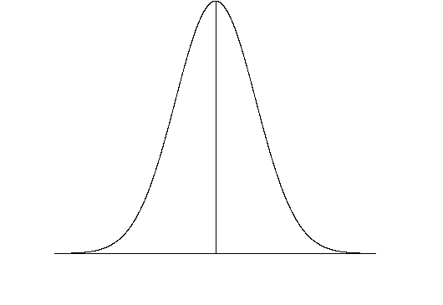
Day shift
Night shift
Null hypothesis
Alternative hypothesis
How do we quantify this difference?
How do we test the alternative hypothesis?

Slide 82
Independent samples t-statistic
Mean of sample of night miners
Mean of sample of day workers
Difference between sample means
Estimation of how well the samples represents the two groups of miners
Square of the pooled variance divided by the number of subjects
Does the same thing as the standard error

Slide 83
t-test as regression
Y_{i} = b₀+b₁X_{i} +ε_{i}
Mean for nightshift group
Baseline: effect of shift if null hypothesis is true
Model error
Mean for dayshift group
What we test:
-is the effect of shift significant
-is the slope for predictor b₁ (i.e. of shift) greater than 0
Effect of shift

Slide 84
What is the general linear model
Model
Description of a phenomenon in terms of its most relevant parameters
Linear
Parameters describe a straight line
Regression
General
Multiple regression
Basic form of many parametric statistics
Social science on the natural sciences model

Slide 85

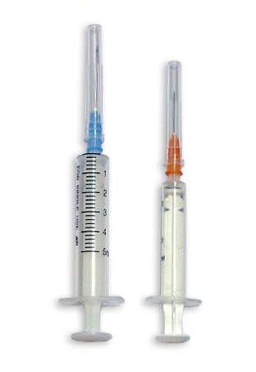
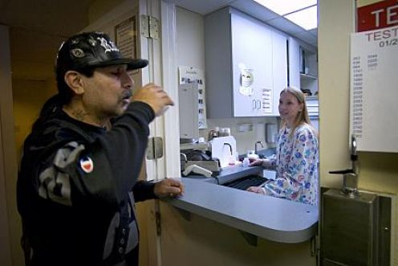
Social policy on the natural sciences model
Observation
See a phenomenon in the world
E.g. Crime increase
Explanation
Construct a theoretical account
E.g. lncreased drug addiction
Prediction
Use the theory to predict new and surprising phenomena
E.g. Methadone clinic will decrease crime
Control
Harness the new knowledge to better the lot of humanity
E.g. set up more methadone clinics

Slide 86
Observe
Explain
Predict
Control
Burglaries per month
Mg methadone dispensed

Slide 87
Observe
Explain
Predict
Control
Burglaries per month
Mg methadone dispensed

Slide 88
Observe
Explain
Predict
Control
Burglaries per month
Y_{i} = b₀+b₁X_{i} +ε_{i}
Mg methadone dispensed

Slide 89
Observe
Explain
Predict
Control
Burglaries per month
Y_{i} = b₀+b₁X_{i} +ε_{i}
Mg methadone dispensed

Slide 90
Public policy:
Fixed minimum methadone
dispensed
Observe
Explain
Predict
Control
Burglaries per month
Y_{i} = b₀+b₁X_{i} +ε_{i}
Mg methadone dispensed

Slide 91
Wrapping it all up…
Concept
Theory
Construct validity
CRITERION OF SUFFICIENCY
Operational definition
Criterion validity
Dependant variable measured in a sample
Sample
data
External validity
CRITERION OF UNIVERSALITY
Population in real world
Reliability
Population at relevant times
“Reality”

Slide 92
Wrapping it all up…
Concept
Theory
Construct validity
Operational definition
Criterion validity
Dependent variable measured in a sample
Sample
data
External validity
Population in real world
Reliability
Population at relevant times
“Reality”

Slide 93
Wrapping it all up…
Concept
Theory
Statistical model
Operational definition
Dependent variable measured in a sample
Sample
data
Sample
statistic
Population in real world
Hypothesis testing
Population at relevant times
“Reality”
Population statistic

Slide 94
Wrapping it all up…
Theory
Statistical model
Variation of regression:
Towards the general linear model
Sample
data
Sample
statistic
Hypothesis testing
“Reality”
Population statistic

